Slide 1
Project Tortoise: Object Detection Framework
Efaz Hossain
Sahithi Mutyala
Biweekly 5

Slide 2
AGENDA
Project Summary
Key Improvements/Achievements
Performance Comparison
Challenges and Solutions
Deployment
Next Steps

Slide 3
Project Summary

Slide 4
Current progress
TLDR
Progress
Limited dataset to patch 0 (train 0, val 0 and test 0)
COCO-style annotations for train/val sets via custom Python script
Tested on YOLO11n and YOLO11s
Scope was refined by limiting dataset to patch 0, which allowed for faster experimentation and reduced storage and computational footprint
COCO-style annotations for the two splits were generated automatically via a Python script and seamlessly integrated within the training pipeline
Model training was followed by multiple rounds of tuning, which led to improvements in mAP(50, 50-95)/Precision/Recall/F1-Score
Exploration into deployment by exporting models into ONNX and TorchScript formats and utilizing AWS and watch notification integration

Slide 5
Key improvements and achievements

Slide 6
Key Improvements and Achievements
Improvements
Achievements
Original pipeline involved using 25% of the original 712 GB and restricted only 5% of the original dataset for usage
Parsed COCO-format annotation files
Generated YOLO-compatible labels using pycocotools
Trained both tuned YOLO11n and YOLO11s models on the filtered dataset and improved detection accuracy
Reconsidered using all 365 object classes which SIGNIFICANTLY improved results
Addressed multiple YAML and extraction-related errors by replacing shell-based tar commands with Python-based extraction methods

Slide 7
Performance Comparison

Slide 8
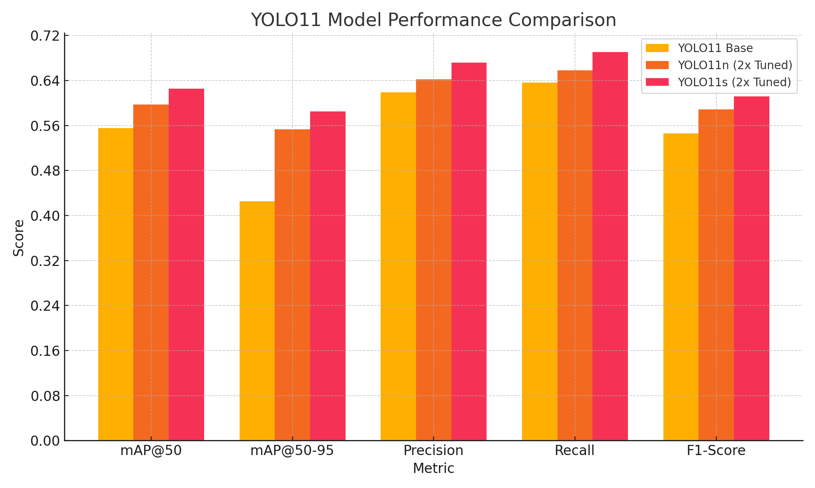
Performance Comparison
Metric | YOLO11 Base | YOLO11n (2x Tuned) | YOLO11s (2x Tuned)
mAP@50 | 0.5555 | 0.6070 | 0.6251
mAP@50-95 | 0.4255 | 0.5832 | 0.5847
Precision | 0.6187 | 0.6420 | 0.6714
Recall | 0.6362 | 0.6580 | 0.6902
F1-Score | 0.5458 | 0.5885 | 0.6120
Time/epoch | 12 min | 9.5 min | 8.5 min
YOLO11n (baseline) started with mAP@50 of 0.5555, showing solid initial performance on household object detection
After tuning, YOLO11n improved to mAP@50 of 0.5970 and F1-Score of 0.5685, indicating better precision-recall balance
YOLO11s outperformed both setups with mAP@50 of 0.6251 and F1-Score of 0.6120, becoming the final deployed model
Precision and recall also improved steadily across model upgrades, showing enhanced detection consistency
Each training iteration led to a reduction in time per epoch (from 12 min to 8.5 min), improving training efficiency
YOLO11s was selected for deployment due to its balance of accuracy, speed, and robustness on real-world tasks

Slide 9
Challenges and Solutions

Slide 10
Challenges and Solutions
Challenges
Solutions
Incompatibility of tar extraction within YAML execution pipeline
Relevant Label File generation
Big Dataset Reduction For Efficiency
Shell-based extraction was replaced with Python’s tarfile module to improve portability
Addressed by validating image existence before generating labels
By focusing on patch 0 only, the data imbalance and training overhead were reduced, allowing easier iterations and testing new model configurations

Slide 11
Deployment

Slide 12
Deployment Pipelines
TorchScript
ONNX
Developed by PyTorch
Allows models to be serialized and ran independently of Python
Supports just-in-time (JIT) compilation for faster inference
Ideal for Py-Torch and custom APIs (Flask)
Compatible with mobile apps, embedded devices and C++ runtimes
Easier transition from training in PyTorch to deployment
Open Neural Network Exchange (ONNX)
An open standard supported by many frameworks
Enables cross-platform compatibility across tools/runtimes
Optimized for edge devices, cloud inference and mobile apps
Works with high-performance runtimes like ONNX Runtime, TensorRT and OpenVINO
Ideal when deploying models outside PyTorch ecosystem

Slide 13

Deployment Prep
Exporting YOLO11s model to ONNX and TorchScript formats for compatibility with various deployment environments
Evaluating inference speed using smaller batch sizes and optimized image resolutions
Testing trained model on a small custom video stream to validate robustness
Beginning development of a lightweight inference script with OpenCV to demonstrate real-time detection

Slide 14
Next Steps

Slide 15
Next Steps
Next Steps
Conclusion
Continue benchmarking YOLO11s and compare against YOLO12 (if possible) under same dataset conditions
Complete inference script with real-time webcam and video stream testing
Package training scrips, model weights and evaluation utilities into a reproducible pipeline
Began preparing final presentation visuals/report
The project is on track with a clean dataset structure, strong training baselines, and clear direction for deployment. This round of improvements not only enhanced model performance but also laid the groundwork for a fully operational inference pipeline.

Slide 16
THANK YOU
Any questions?

